Slide 1



Slide 2
Outline
Define “Video Game”
Video Game Industry Overview
Game Development Process :
Game Design
Game Genres
Design Documents
Game Art
2D
3D
Programming
Game Engines
Programming sub-disciplines
Audio
QA
The Community

Slide 3



Define “Video Game” ?!
What’s the Difference between these three ?! :
A Software
A Game
A Movie

Slide 4
Here’s the difference
An Interactive Medium :
Interactivity is what makes games differ from Movies and other art forms .
The content of the game as a Medium is what makes it differs from other software .
And obviously they are more fun .

Slide 5

GAMES HAVE GOT IT ALL
Art
Game Trivia
Business
Science & Tech

Slide 6










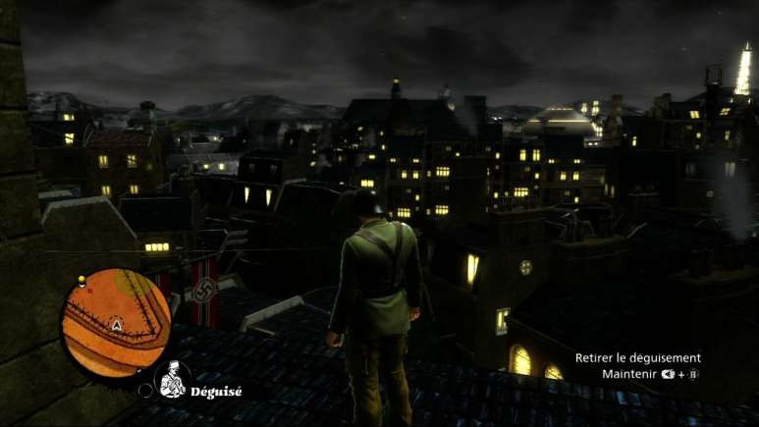
















Slide 7
Game Structure
Games have a different structure than any other software
Start up
Introductory Movie
Front End
Game Options
Sound Options
Video Options
Loading Screen
Main Game
Introduction
Gameplay
– game modes
Pause Options
End Game Movie
Credits
Shut down

Slide 8
Game Loop
// a simple game loop in C++
int main()
{
Initialize(); while (true)
{
Process(); Update();
Render();
}
ShutDown();
}

Slide 9
What actually happens
While(true)
{
/* Process controller input : Checks for player’s input .. For example ,
if the player hits spacebar then make the character jump … etc*/
Process();
/* Update entities : this is where the game reacts to the changes the player’s made as well as updates the game state */
Update();
/*Update Graphics : draw the background, draw sprites, update HUD elements, etc */
Render();
}

Slide 10

Now , That we know what games are , let’s talk Business.

Slide 11


Games VS Movies (in terms of sales)
Vs
$239 million
First Week Revenue
$500 million
First Week Revenue
Source : Video Game Industry Trends by Ferrarra

Slide 12
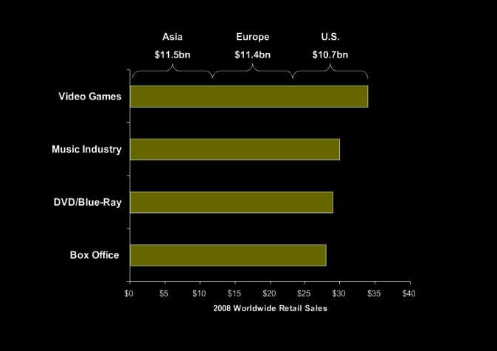
Games Market
Source : Video Game Industry Trends by Ferrarra

Slide 13
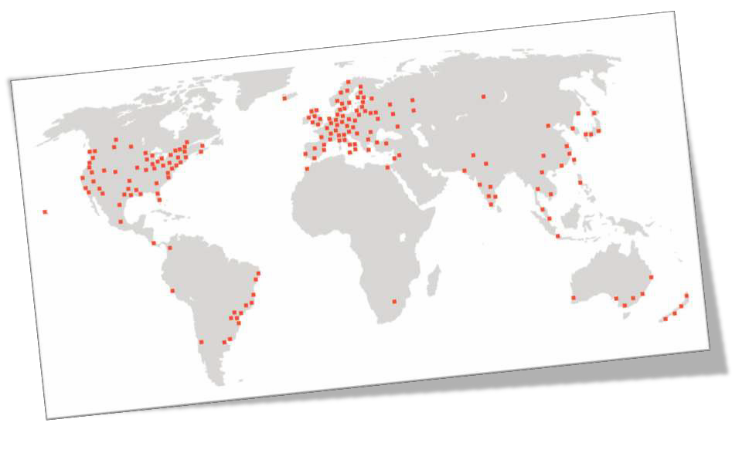
Game Development Map

Slide 14
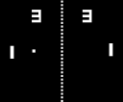

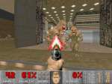

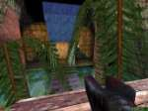

A brief History
1972 : Pong (Hardware)
Classics : Atari , NES , SNES , Commodre64 , NeoGenesis ,…ets
1993 : Doom (idTech 1)
1995 : Software-Rendered Engines (CPU-only)
2007 : Unreal Engine 3
1998 : Unreal (Hardware 3D - GPU)
Two decades of GPU dependence

Slide 15




Indie Scene
Obviously Independent
No publishers , may come later though.
Low-Budget and sometimes no budget at all .
Individuals and small teams .
Simply , It’s the opposite to mainstream games .
You’re your own boss .
Seeks Innovation and explore new aspects in game design and storytelling and even art forms .

Slide 16
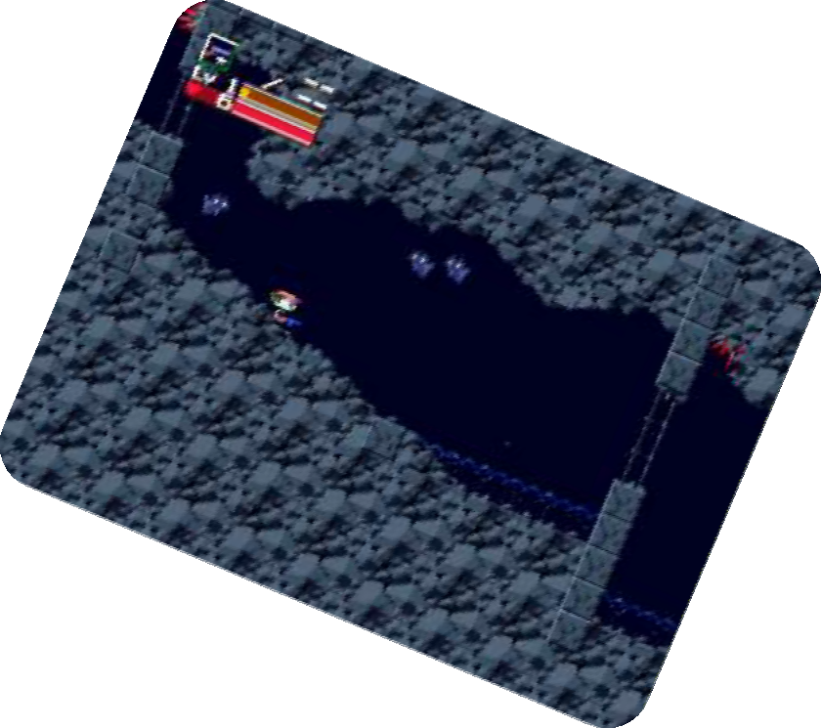

Why indie ?!
Though it’s very time consuming process .
There is really no reliable financial return .
It could drive you crazy , you do all the job .
But let’s look at the bright side :
You’ll be working on something you really want to do .
You’re your own boss .
If you’re creative enough you’ll make a hit sooner or later like this guy called “Pixel” from Japan and his hit “Cave Story” .

Slide 17
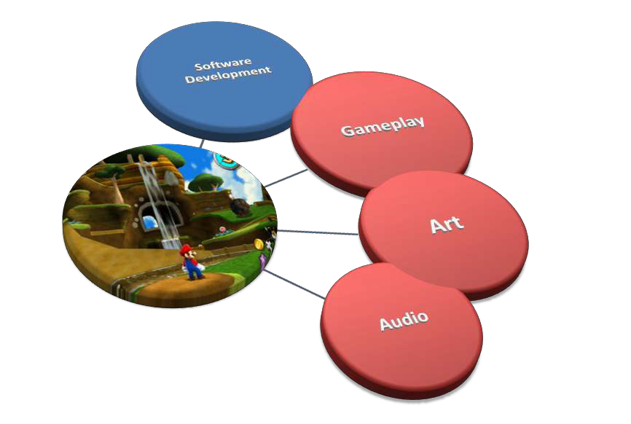
Game Development Process

Slide 18




Game Development Process
Pitch (Concept Document )
Prototype (Proof of concept)
Pre-production
GDD
Project Plan
Production
Design
Programming
Art Production
Audio Production
QA (Testing)
Postproduction
Maintenance
Costumer Services
Patches and updates

Slide 19




Three Main Milestones
Gold Master
Beta version
Alpha Protocol

Slide 20

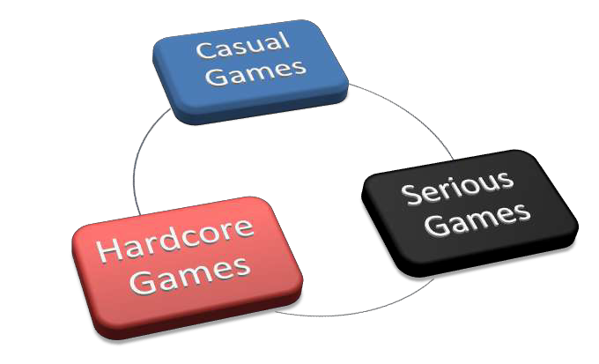
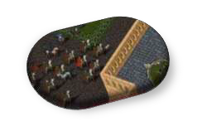
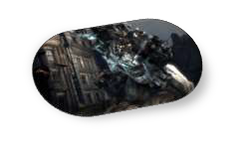
Three Categories ?!

Slide 21
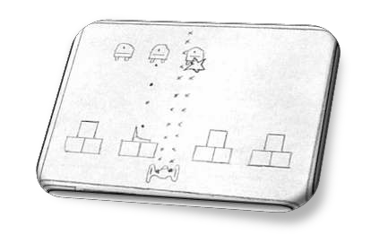
Game Design
The Content and Rules of the Game .
You describe what the game will look and act like .
Game Design is very critical and requires experience and knowledge .

Slide 22






















Game Genres
Can be used to describe : Gameplay , Story and even the perspective … e.g. (FPS , RPG..)
Describes the Story
Describes the Gameplay
Describes the Perspective

Slide 23



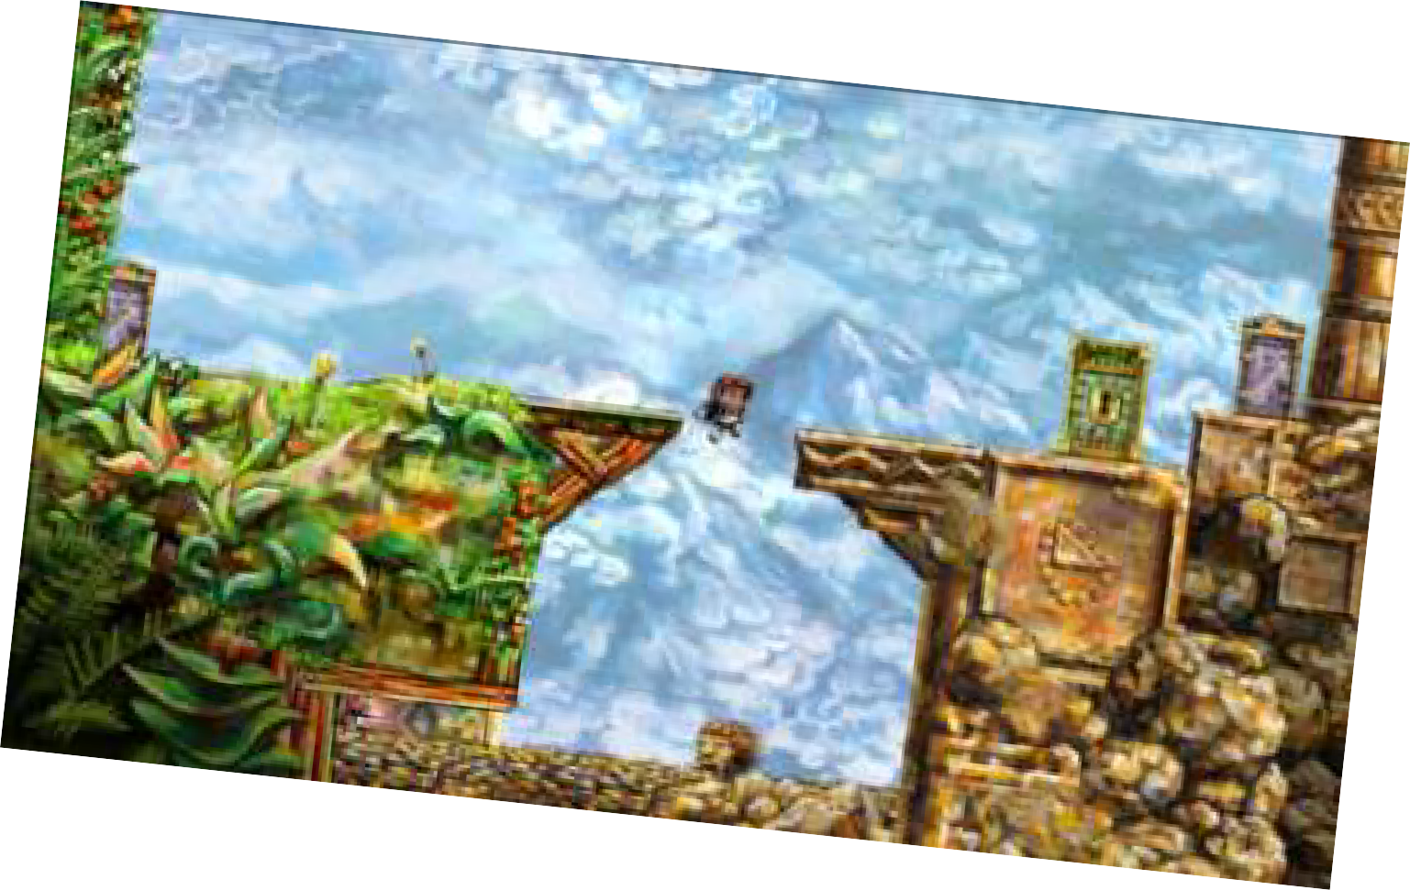
Game Art
2D Art :
Concept Art
Sprites
Texture Art
UI Artist

Slide 24

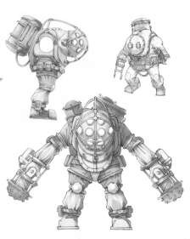

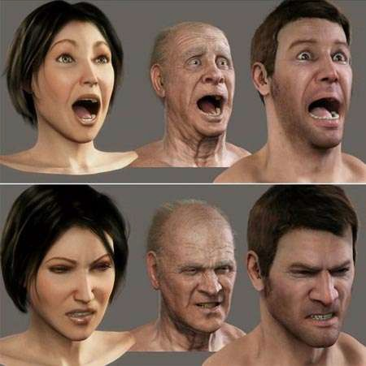

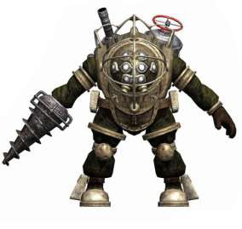


Game Art :: 3D
Modeling
Concept Art
Wrapping & Texturing
Animation

Slide 25

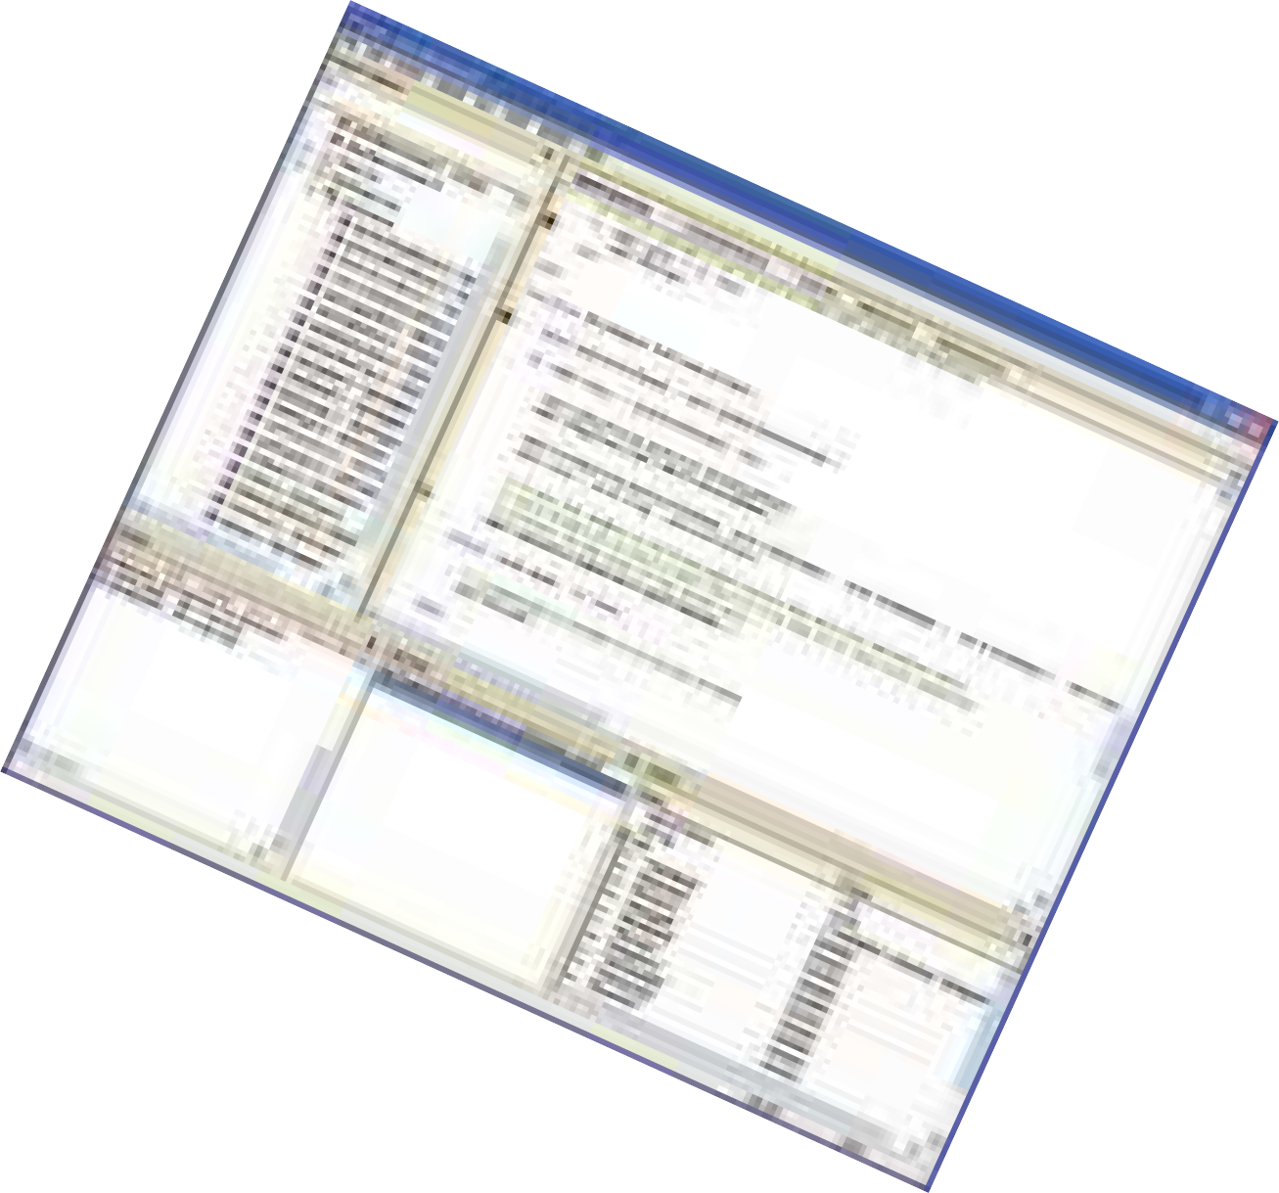
Game Programming sub-disciplines
Gameplay Programming
AI Programming
Tools Programming
Graphics Programming

Slide 26

APIs and SDKs
The difference between APIs and SDKs .
API (Application Programming Interface) :-
Software interfaces that OS, libraries, and services provide
You can take advantage of their particular features.
XNA , DirectX and OpenGL .
SDK (Software Development Kit) : Collection Of libraries , APIs and tools .

Slide 27

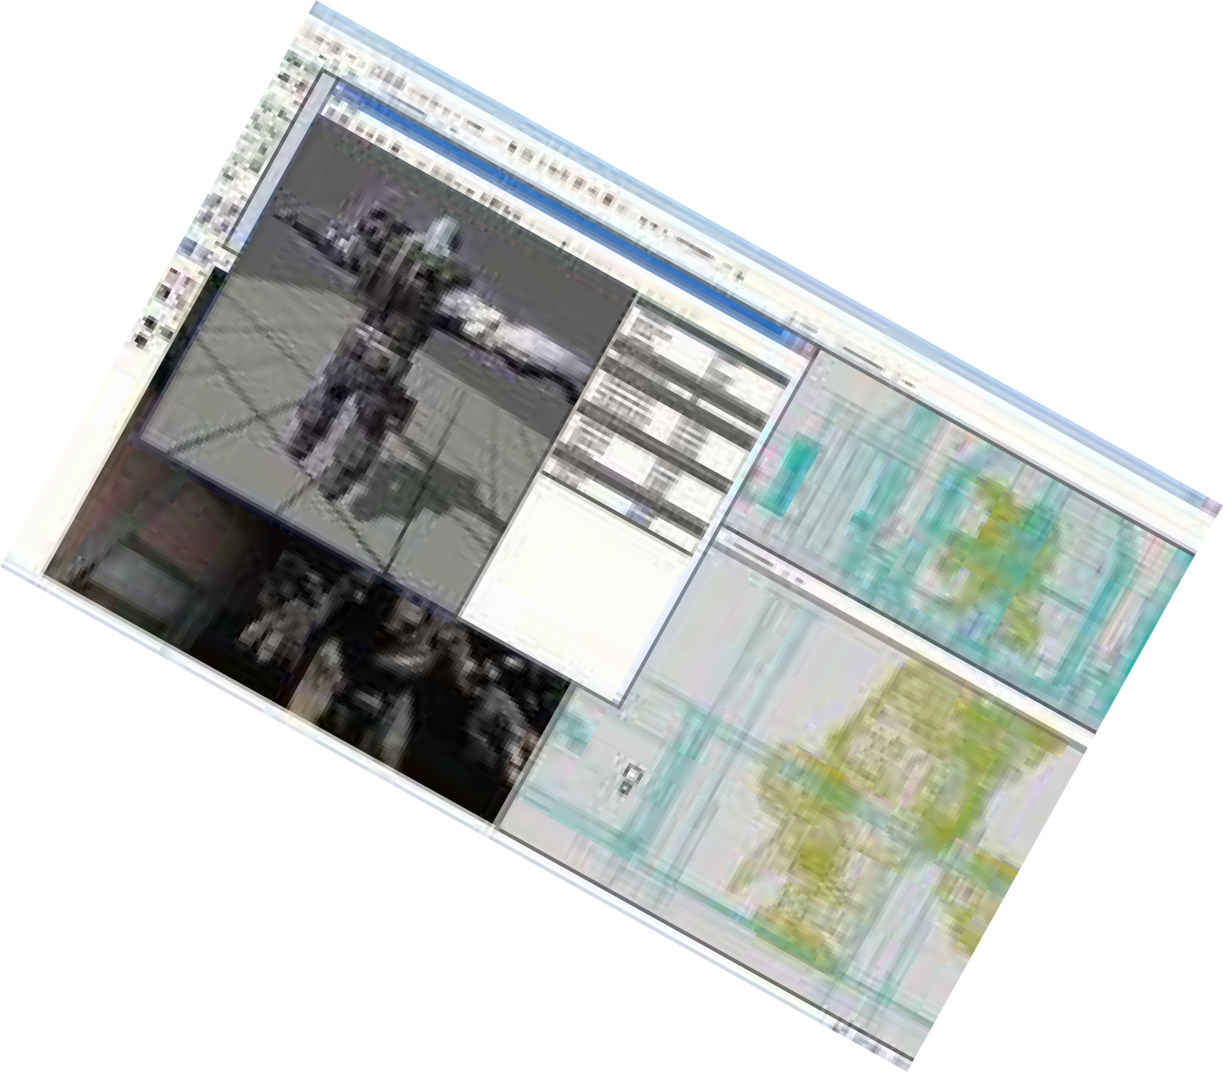
Game Engines
In-house Game Engines .
Scimitar (Assassin’s Creed)
Two types of Game Engines :-
Full tool chain (UnrealEngine 3 ,Unity )
Middleware & Integrated libraries (SDL , OGRE3D)

Slide 28

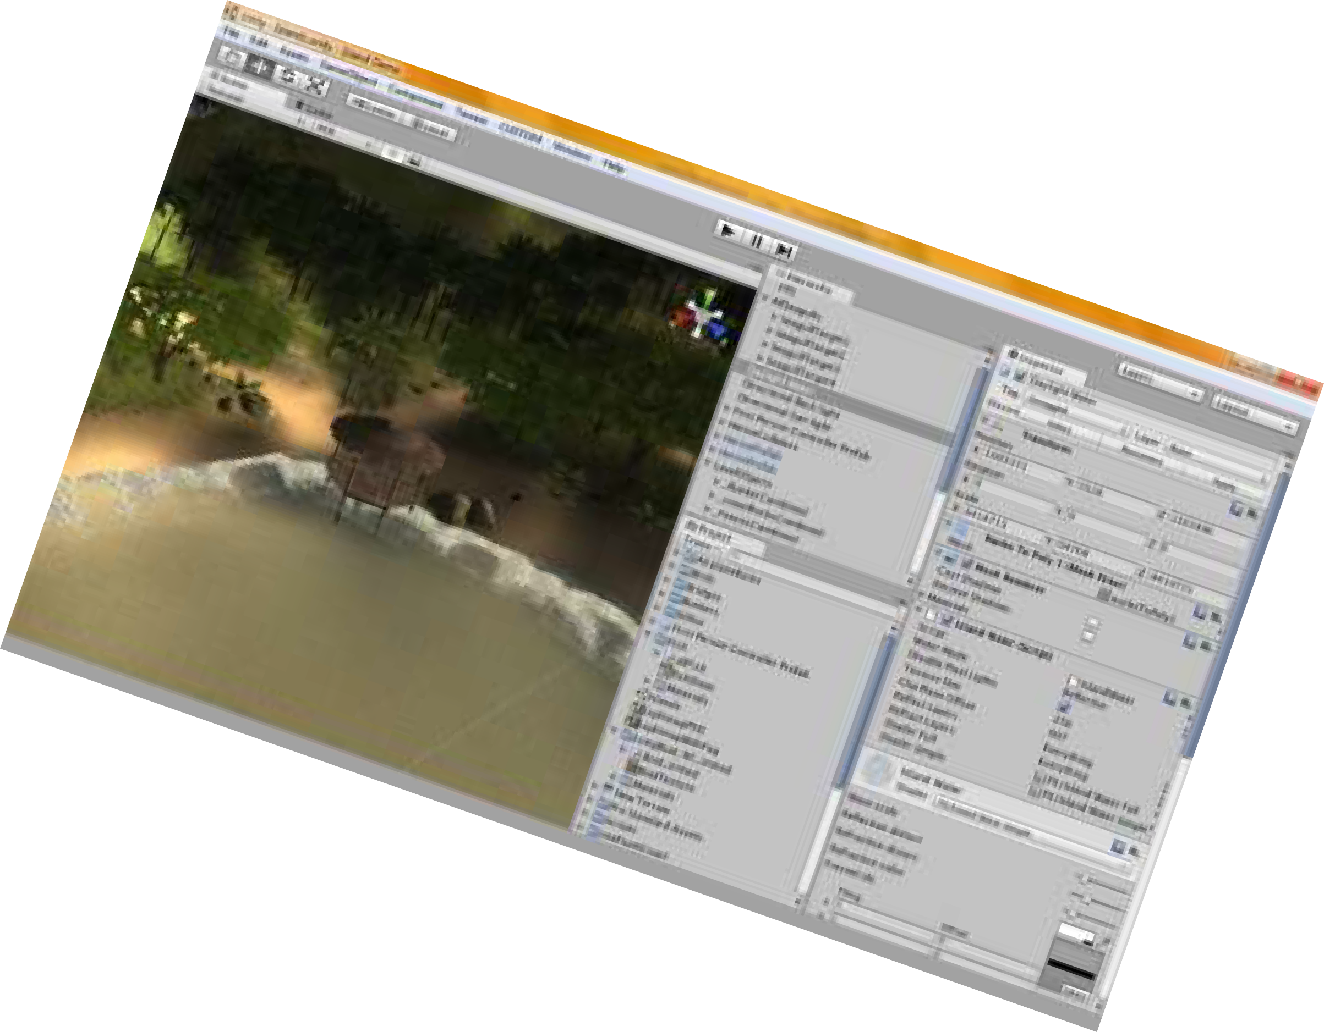

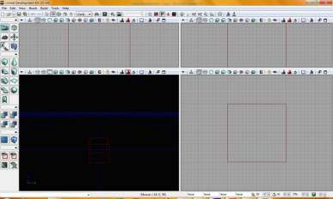
Programming Tools
Unity .
UDK .

Slide 29
The Community
IGDA
CMP :-
Gamasutra.com
GameCareerGuide.com
GameDev.net
Tigsource.com

